Slide 1
Machine Learning
Table of Contents
01
Introduction
05
Using Machine Learning for Pedestrian Detection and Attribute Classification to Improve Road Safety
Model 2- VAE
02
Project Summary
06
Sample code- VAE
03
Model 1- LSTM
07
Model Comparison
04
Sample Code- LSTM
08
Conclusion and Recommendations
Made by Group 3

Slide 2
Table of Contents
01
02
03
04
Machine Learning
Machine Learning
Introduction
Using Machine Learning for Pedestrian Detection and Attribute Classification to Improve Road Safety
05
Model 2- VAE
Project Summary
06
Sample code- VAE
Model 1- LSTM
07
Model Comparison
Sample Code- LSTM
08
Conclusion and Recommendations

Slide 3
Introduction
01
Why This Project?
Predicting pedestrian motion is essential for traffic safety in cities.`
We use deep learning models to analyze past motion and predict future poses in real-world scenarios.

Slide 4
01
Introduction
Why This Project?
GOAL
Build a deep learning system that predicts the future 3D pose of pedestrians using real-world image sequences.
Predicting pedestrian motion is essential for traffic safety in cities.`
We use deep learning models to analyze past motion and predict future poses in real-world scenarios.

Slide 5
Project Summary
01
Introduction
Why This Project?
GOAL
Build a deep learning system that predicts the future 3D pose of pedestrians using real-world image sequences.
Predicting pedestrian motion is essential for traffic safety in cities.
Predicting pedestrian motion is essential for traffic safety in cities.`
We use deep learning models to analyze past motion and predict future poses in real-world scenarios.
02

Slide 6
Project Summary
01
Introduction
The Project Focuses On
02
GOAL
Build a deep learning system that predicts the future 3D pose of pedestrians using real-world image sequences.

Slide 7
Project Summary
The Project Focuses On
02
Detecting pedestrians in images and videos
Detecting pedestrians in images and videos
Recognizing their visual attributes (e.g., gender, bag).
Recognizing their visual attributes (e.g., gender, bag).
Using real-world datasets from surveillance cameras.
Using real-world datasets from surveillance cameras.

Slide 8
Project Summary
The Project Focuses On
Predicting future pedestrian poses using deep learning models
02
03
Model 1 – LSTM
Analyzing temporal motion data from video sequences
Training models on real-world datasets like 3DPW
Based on public data and models available online

Slide 9
Model 1 – LSTM
What is LSTM?
Long Short-Term Memory is a model built on a specialized Recurrent Neural Network architecture specifically designed to handle long-term dependencies in sequential data by overcoming the vanishing gradient problem.
Uses memory cells and gates to manage information flow.
03
How it Works?
What is YOLOv3? A fast object detection model that finds people in images or videos in real-time.
What is YOLOv3? A fast object detection model that finds people in images or videos in real-time.
Function: Detects people in images/videos in real-time.
•⁠ ⁠How it works:
- Splits the image into grids.
- Predicts bounding boxes for people.
•⁠ ⁠Dataset: Public surveillance video (e.g., Milan station).

Slide 10
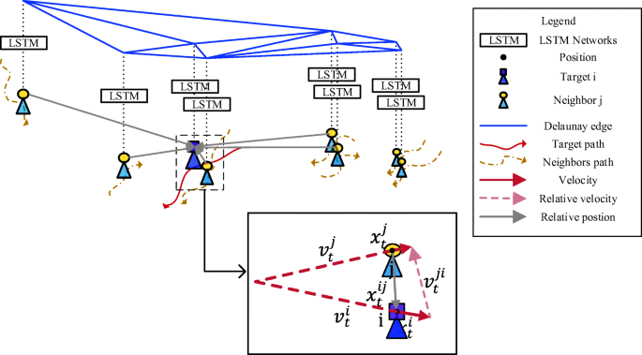
03
Model 1 – LSTM
Why LSTM?
Pedestrian motion is sequential and time-dependent
LSTM learns movement patterns by remembering previous positions.
Helps predict how a pedestrian’s global position evolves by learning patterns in movement speed and direction.
What is LSTM?
Long Short-Term Memory is a model built on a specialized Recurrent Neural Network architecture specifically designed to handle long-term dependencies in sequential data by overcoming the vanishing gradient problem.
Uses memory cells and gates to manage information flow.

Slide 11
How it Works?
03
Model 1 – LSTM
Why LSTM?
Pedestrian motion is sequential and time-dependent
LSTM learns movement patterns by remembering previous positions.
Helps predict how a pedestrian’s global position evolves by learning patterns in movement speed and direction.
What is LSTM?
Long Short-Term Memory is a model built on a specialized Recurrent Neural Network architecture specifically designed to handle long-term dependencies in sequential data by overcoming the vanishing gradient problem.
Uses memory cells and gates to manage information flow.
Sequential Input
The LSTM model receives pose sequences frame by frame.
Memory Mechanism
At every time step, the LSTM updates its cell state.
Gates that are responsible for Information Flow:
Forget Gate, Input Gate, Output Gate
Output Prediction: The final output at each step is a vector representing the predicted global speed or movement direction, which is then converted into future poses using a speed-to-position conversion function
04
Sample Code – LSTM

Slide 12
How it Works?
03
Model 1 – LSTM
Practical example:
In our project, we used the Global Model (net_g), an LSTM-based model, to predict global motion. The LSTM model receives a sequence of past 3D poses from a pedestrian. The model analyzes how the pedestrian has been moving and predicts how that motion will continue over the next few frames.
Why LSTM?
Pedestrian motion is sequential and time-dependent
LSTM learns movement patterns by remembering previous positions.
Helps predict how a pedestrian’s global position evolves by learning patterns in movement speed and direction.
Sequential Input
The LSTM model receives pose sequences frame by frame.
Memory Mechanism
At every time step, the LSTM updates its cell state.
Gates that are responsible for Information Flow:
Forget Gate, Input Gate, Output Gate
Output Prediction: The final output at each step is a vector representing the predicted global speed or movement direction, which is then converted into future poses using a speed-to-position conversion function
Click here to see how it works [video]
04
Sample Code – LSTM

Slide 13
How it Works?
03
Model 1 – LSTM
Practical example - Dataused:
In our project, we used the Global Model (net_g), an LSTM-based model, to predict global motion. The LSTM model receives a sequence of past 3D poses from a pedestrian. The model analyzes how the pedestrian has been moving and predicts how that motion will continue over the next few frames.
To see the structure of the data click here
Sequential Input
The LSTM model receives pose sequences frame by frame.
Memory Mechanism
At every time step, the LSTM updates its cell state.
Gates that are responsible for Information Flow:
Forget Gate, Input Gate, Output Gate
Output Prediction: The final output at each step is a vector representing the predicted global speed or movement direction, which is then converted into future poses using a speed-to-position conversion function
04
Sample Code – YOLOv3

Slide 14
Sample Code – LSTM
03
Model 1 – LSTM
Practical example:
In our project, we used the Global Model (net_g), an LSTM-based model, to predict global motion. The LSTM model receives a sequence of past 3D poses from a pedestrian. The model analyzes how the pedestrian has been moving and predicts how that motion will continue over the next few frames.
04

Slide 15


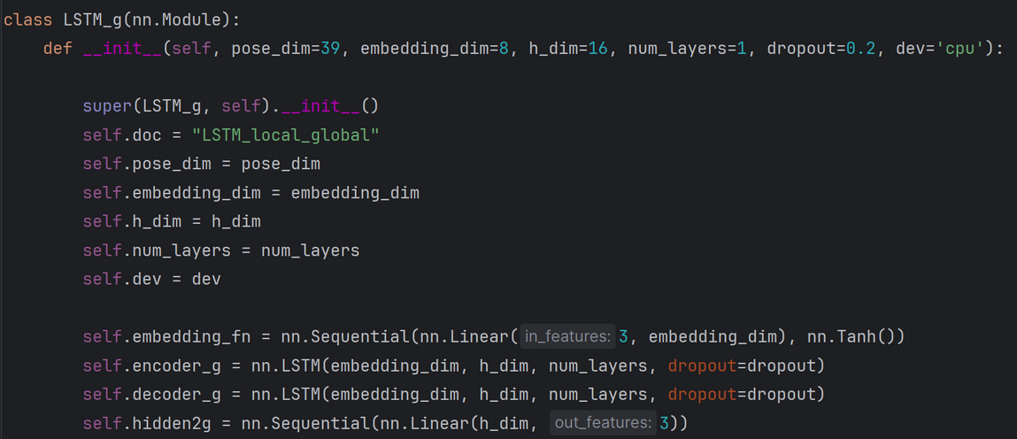
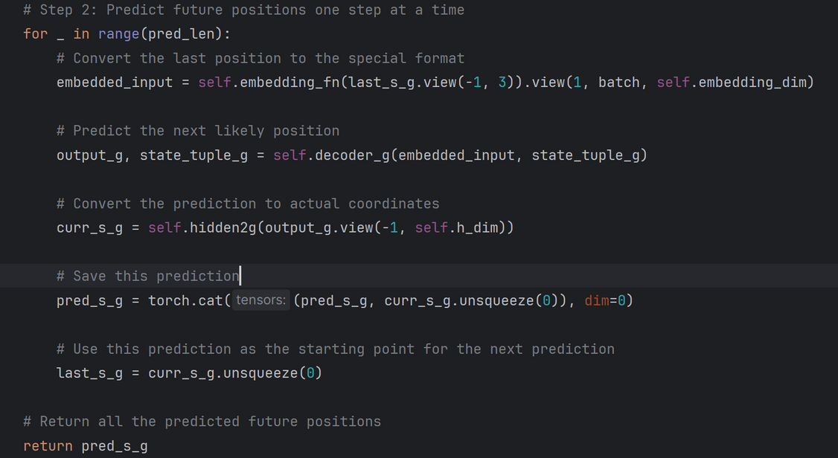

04
Sample Code – LSTM
from model.py
05
Model 2 – VAE

Slide 16
Model 2 – VAE
04
Sample Code – YOLOv3
What is VAE?
Variational Autoencoder (VAE) is a generative model based on autoencoders. It encodes data into distributions (mean and variance) in a latent space instead of a single point, enabling diverse and uncertain data generation.
05
Why VAE for Data Generation?
VAEs excel at encoding high-dimensional data into a lower-dimensional latent space, making them ideal for generating new, realistic data that resembles the training set. This is useful for applications like image synthesis, anomaly detection, and data augmentation.

Slide 17
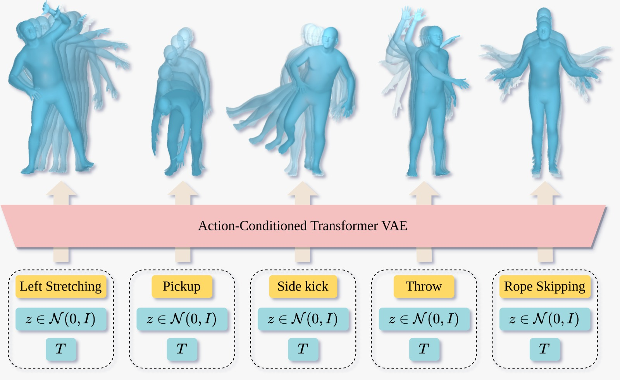
Model 2 – VAE
05
How It Works:
Sequential Input
Encoding
Sampling Decoding
Loss Function
Practical Example in Our Project:
We use a VAE-based model to generate synthetic data, capturing the data's structure to augment our training set and enhance performance in machine learning tasks.
What is VAE?
Variational Autoencoder (VAE) is a generative model based on autoencoders. It encodes data into distributions (mean and variance) in a latent space instead of a single point, enabling diverse and uncertain data generation.
Why MoveNet?
Real-time performance (30+ FPS).
Two variants:
Lightning: Fast, for mobile and edge devices.
Thunder: More accurate, for precision needs.
Great for recognizing human movement.
Applications in Autonomous Vehicles:
Predicts pedestrian movements by analyzing posture.
Helps differentiate moving people from static obstacles.
Why VAE for Data Generation?
VAEs excel at encoding high-dimensional data into a lower-dimensional latent space, making them ideal for generating new, realistic data that resembles the training set. This is useful for applications like image synthesis, anomaly detection, and data augmentation.

Slide 18
Model 2 – VAE
05
What is VAE?
Variational Autoencoder (VAE) is a generative model based on autoencoders. It encodes data into distributions (mean and variance) in a latent space instead of a single point, enabling diverse and uncertain data generation.
How It Works:
Sequential Input
Encoding
Sampling Decoding
Loss Function
Practical Example in Our Project - Dataused
We use a VAE-based model to generate synthetic data, capturing the data's structure to augment our training set and enhance performance in machine learning tasks.
To see the structure of the data click here
Click here to see how it works [video]
Dataset Used:
normally MoveNet is trained on datasets like COCO Key points.
Why VAE for Data Generation?
VAEs excel at encoding high-dimensional data into a lower-dimensional latent space, making them ideal for generating new, realistic data that resembles the training set. This is useful for applications like image synthesis, anomaly detection, and data augmentation.

Slide 19
Sample Code- VAE
How It Works:
Sequential Input
Encoding
Sampling Decoding
Loss Function
Practical Example in Our Project:
We use a VAE-based model to generate synthetic data, capturing the data's structure to augment our training set and enhance performance in machine learning tasks.
06

Slide 20
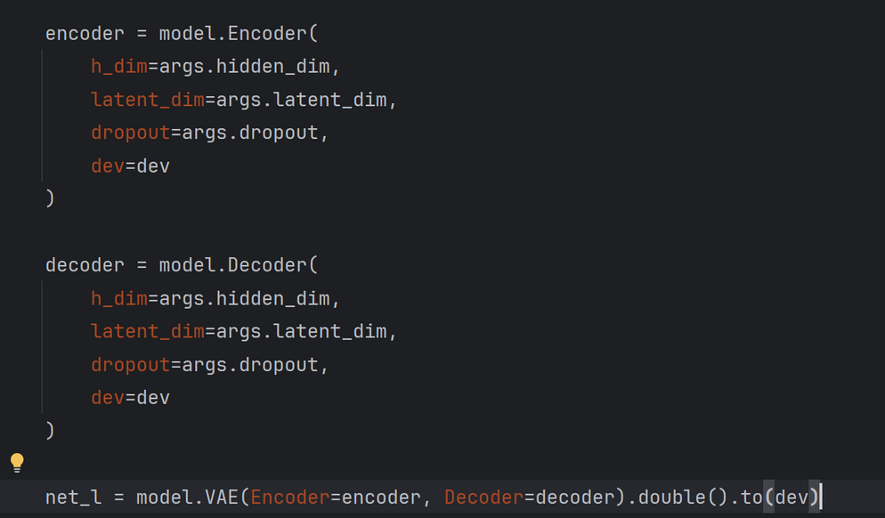
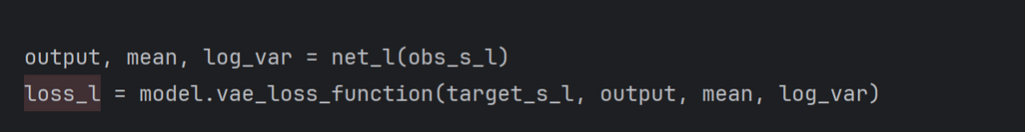
06
Sample Code- VAE
MoveNet output:
Movnet cannot estimate more than 1 objects at once
from train.py
07
Comparison Between Models

Slide 21
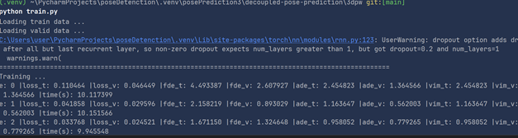
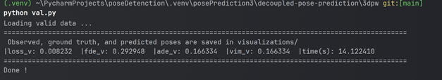
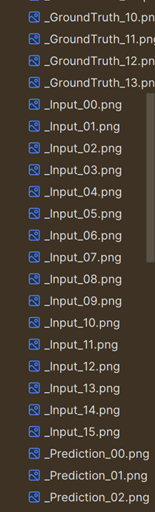
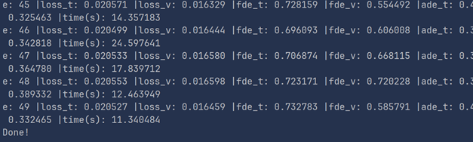
Usage example :

Slide 22
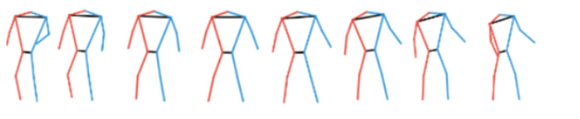
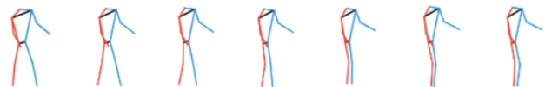
Final output
Image :
Predicted :

Slide 23
Comparison Between Models
06
Sample Code- MoveNet
•⁠ ⁠Example of how a trained CNN can classify a person’s image.
•⁠ ⁠Simulates HP-CNN’s behavior (simplified version).
MoveNet output:
Movnet cannot estimate more than 1 objects at once
07
Model | Purpose | Strength | Limitation
LSTM | predict sequential or time-series data | Captures long-term dependencies in sequence data | Training is slow and struggles with very long sequences
VAE | generate new data samples | Learns latent representations for generative tasks | Generated outputs can be blurry

Slide 24
Conclusion & Recommendations
07
Comparison Between Models
Model | Purpose | Strength | Limitation
LSTM | predict sequential or time-series data | Captures long-term dependencies in sequence data | Training is slow and struggles with very long sequences
VAE | generate new data samples | Learns latent representations for generative tasks | Generated outputs can be blurry
08

Slide 25
Conclusion & Recommendations
Model | Purpose | Strength | Limitation
LSTM | predict sequential or time-series data | Captures long-term dependencies in sequence data | Training is slow and struggles with very long sequences
VAE | generate new data samples | Learns latent representations for generative tasks | Generated outputs can be blurry
07
Comparison Between Models
08
ML models like LSTM and VAE are powerful tools for road safety.
•⁠ ⁠Public datasets (e.g., RAP) make it easier to build and test models.
•⁠ ⁠Simple code implementations show how these systems work in real life.
•⁠ ⁠These models can be used in smart cars, surveillance, and traffic systems.

Slide 26
08
Conclusion & Recommendations
ML models like LSTM and VAE are powerful tools for road safety.
•⁠ ⁠Public datasets (e.g., RAP) make it easier to build and test models.
•⁠ ⁠Simple code implementations show how these systems work in real life.
•⁠ ⁠These models can be used in smart cars, surveillance, and traffic systems.

